Slide 1
IP-TV over IMS
Group 7

Slide 2
Progress Made
Installation and Configuration
OpenIMS core
Mobicents/JBoss
Working Demonstration
Mobicents and client integration
Configuration of app server to achieve UE service attachment

Slide 3
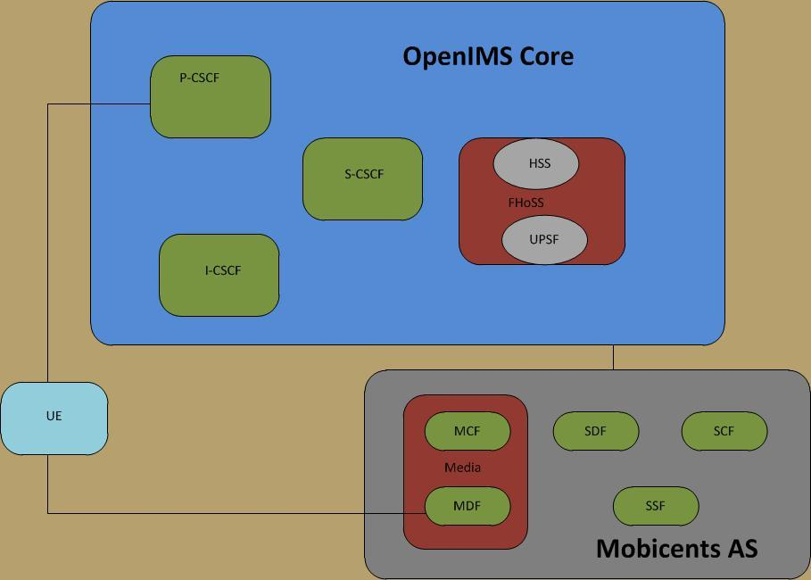

Slide 4
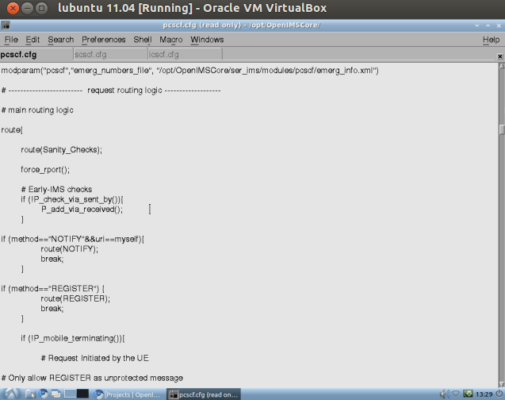

Slide 5
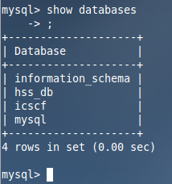
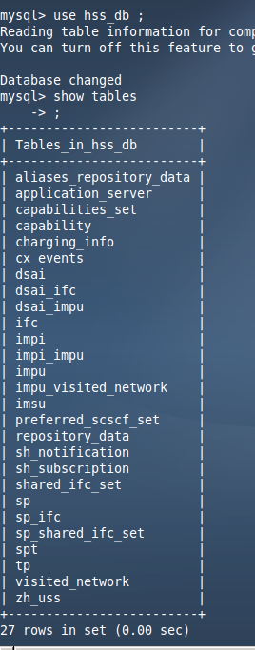
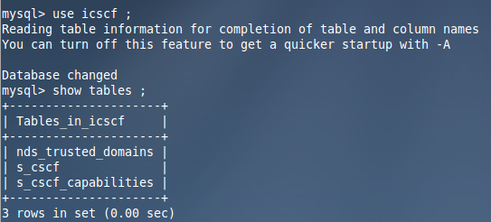
SQL server

Slide 6
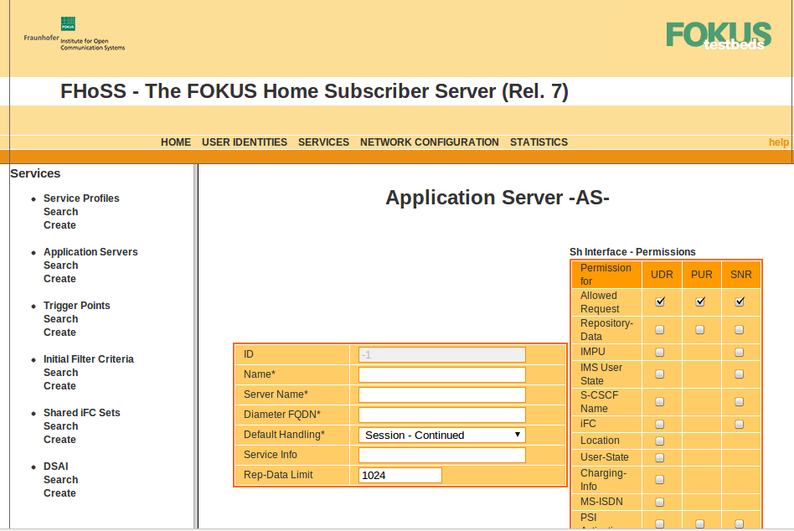

Slide 7
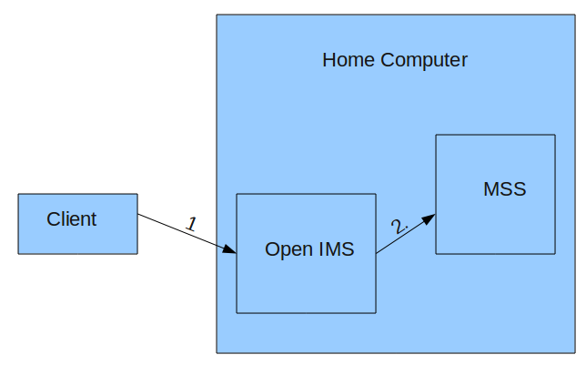
Demonstration

Slide 8
Plan of action
AS development
Client development
System Integration
Debugging, testing, and verification
Implementing added functionality (if time permits) - Parental control, personalised user accounts, subtitle switching

Slide 9
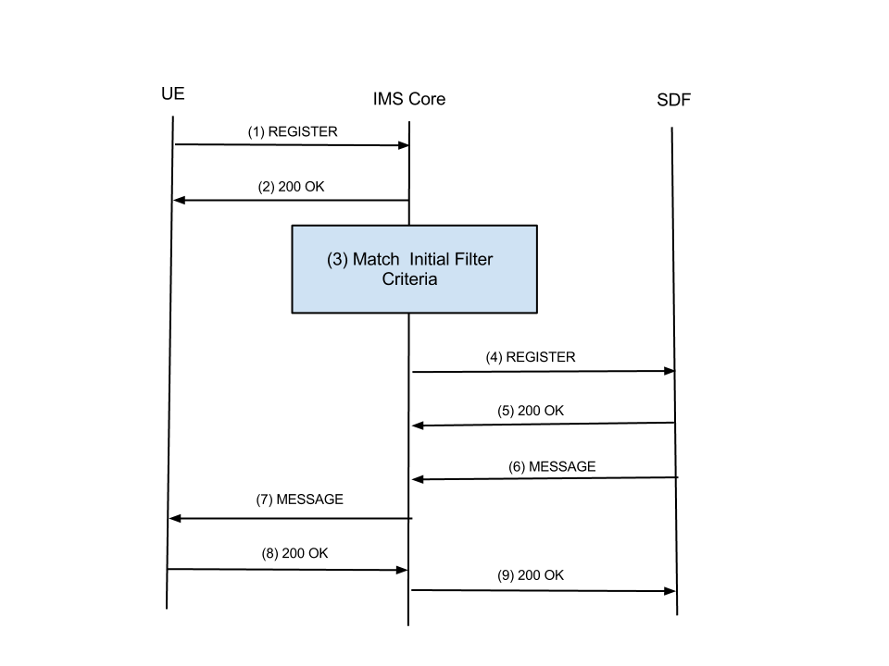
UE Service Attachment

Slide 10
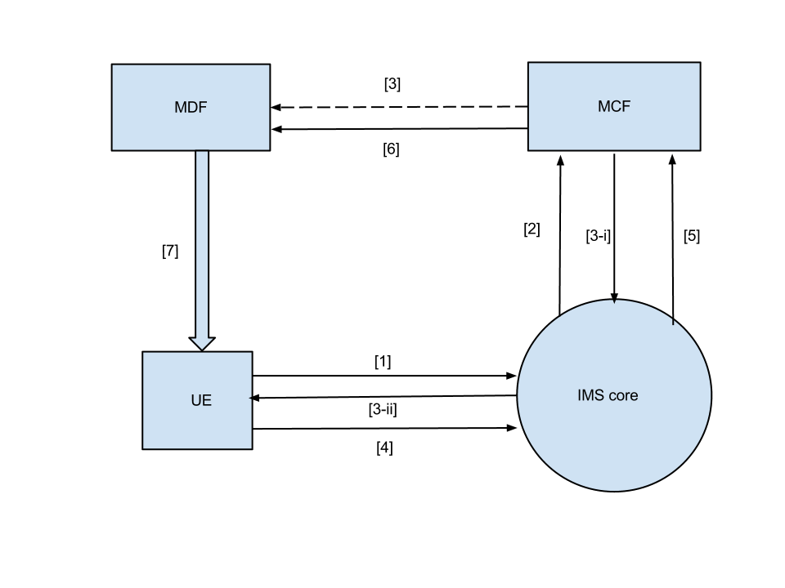
MDF to UE streaming

